Slide 1
Final Project : Generative AI from OPL to Software
26-1-R-7
Presenting: Omri Spitzer and Stav Avraham

Slide 2
Introduction
Software development begins with client requirements.
Used system models: UML, SysML, OPM
Current users use GenAI
GenAI agents lead to malfunctions and hallucinations
We focus on OPM and its corresponding language - OPL
Notes:
Developing well-engineered software begins with translating the client’s requirements
To successfully design this architecture, engineers typically rely on system diagrams, such as - UML, SysML, OPM and more - which aim to design the system’s structure and behavior.
Recently, Generative AI has become widely used, with many advantages. Because of this accessibility, clients increasingly attempt to create software by describing their needs to an AI tool and expecting it to generate a complete solution.
Although GenAI tools can generate code, they may not meet the requirements, have mistakes, or fill in missing information with assumptions that do not match the client’s intent.
To discuss about bridging the gap between free-text ambiguity and reliable software architecture, for our research, we chose OPM and its corresponding language OPL as our basis for the system structure.

Slide 3
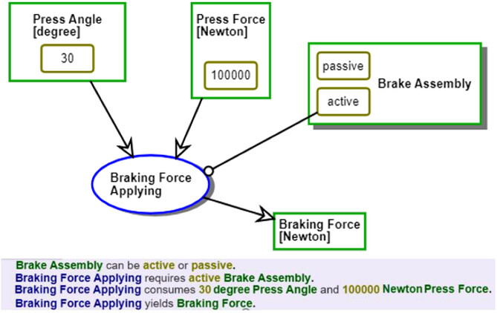
Levi-Soskin, N., Marwedel, S., Jbara, A., & Dori, D. (2024). Enhancing conceptual models with computational capabilities: A methodical approach to executable integrative modeling. Systems Engineering, 27, 759–770. https://doi.org/10.1002/sys.21750
Notes:
Example of OPM & OPL file

Slide 4
Background
ChatGPT - User friendly genAI. May cause hallucinations that require validation layers.
Base44 - Application for full-stack builder using AI. No formal evidence for transformation requirements correctness.
Visual Paradigm - Full system designer with class generator option. Non-executable code generated.
MAXIM via OPCloud - OPM model interactions visualizer. Doesn’t generate code.
Notes:
What solutions are existing today? 1. chatGPT is user-friendly, and supports a natural language communication. However, its generated responses may produce outputs that are syntactically correct yet semantically incorrect
2. Base44 is an AI-driven application builder,which allow users to describe an application in natural language and automatically generate full-stack solutions. However, Base44 offers no formal guarantees of correctness, consistency, or traceability, relying instead on unstructured prompts.
3. Visual Paradigm - modeling tool that supports the visual representation of software systems like UML and SysML. While valuable for communicating design decisions, However, it primarily operates at the design level and does not generate executable code.
4. Finally, another software solution we reviewed is MAXIM via OPCloud.
When executed, the model visually shows the interaction between objects and processes. However, MAXIM does not support code generation and require manual intervention.

Slide 5
Research Questions
RQ1: Does code generated by an AI agent pre-trained on OPL logic, is more consistent with client requirements, compared to code developed manually by human programmers?
RQ2: To what extent do the results generated by the AI agent meet the specified client requirements, while being executable?

Slide 6
Answers to Research Questions
ANS1: Comparing code generated by the proposed AI agent with human generated code, using the evaluation metrics proposed.
ANS2: Succeeding in the Success Factors (executable code, coverage score, ext.).

Slide 7
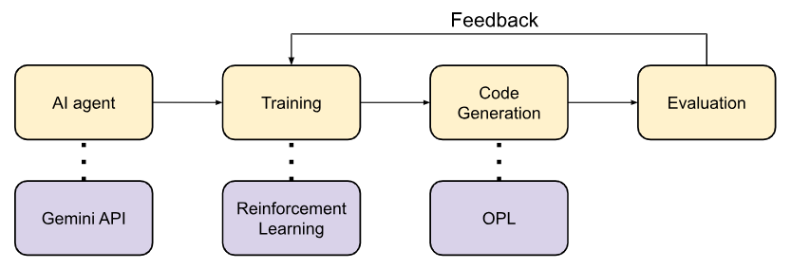
Our Solution

Slide 8
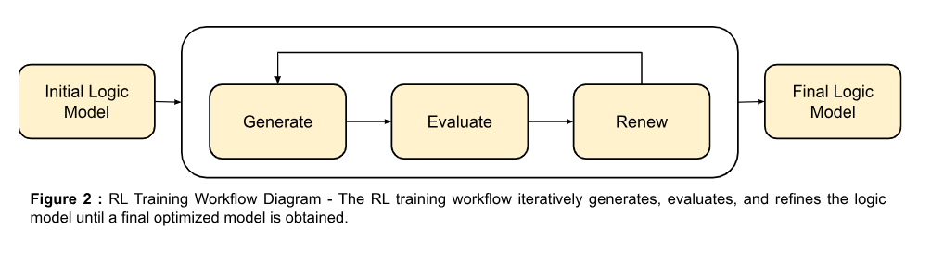
Our Solution

Slide 9
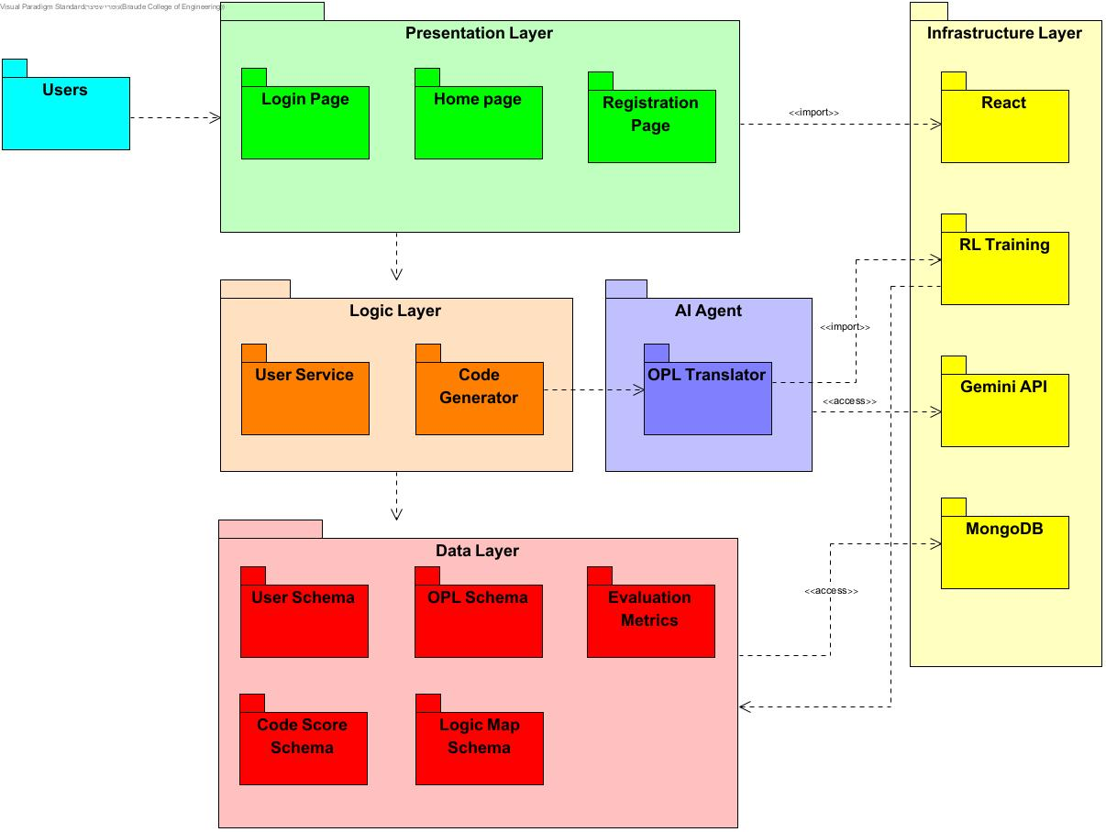
Architecture

Slide 10
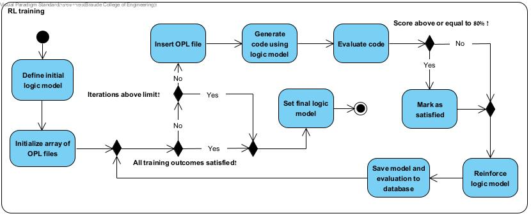
Training Flow - Reinforcement Learning

Slide 11
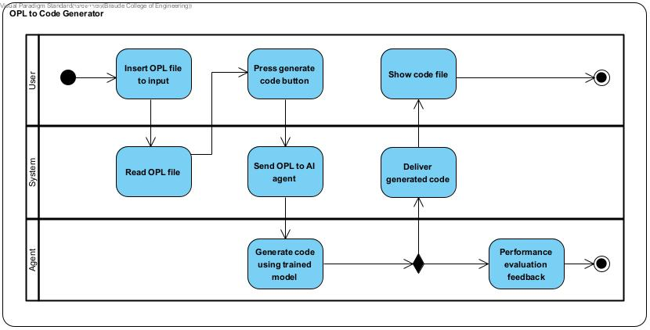
Code Generation Flow

Slide 12
Success Factors
Agent evaluation score above 80%
Superior performance compared Gemini
Executable code generation
Requirement implementation score above 90%
Logical correctness of generated output

Slide 13
Testing Plan
Test | Explanation
Executable Output After Training | Code runs without runtime errors and logically correct
Code Generation Trigger | Code file is generated and returned without system crash
Performance Constraint | Most training OPL score above 80%
Gemini API Connection | Successful connection with Gemini API
Time Constraint | System can handle large objects and processes

Slide 14
Challenges
Data availability
Technical expertise
Technological environment
Evaluation metrics

Slide 15
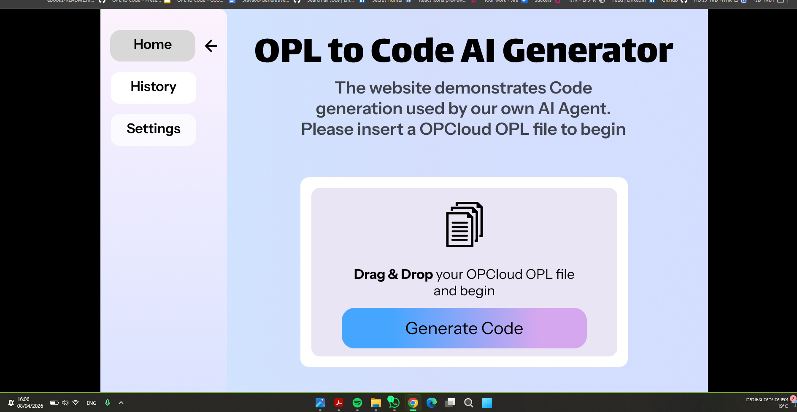

Slide 16
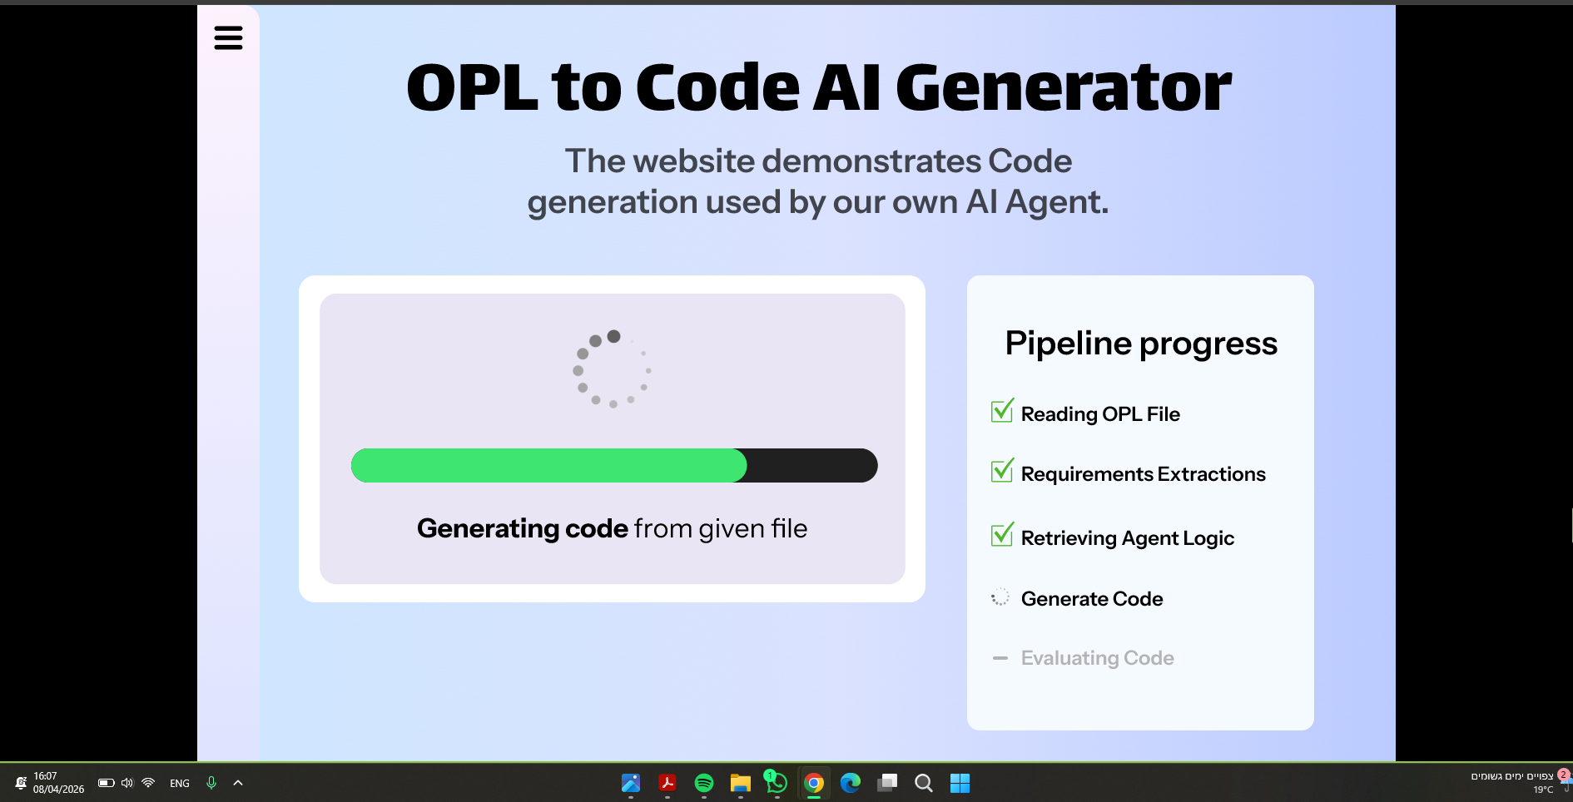

Slide 17
Questions & Answers

Slide 18
Thank you

